Slide 1
19CSE305 MACHINE LEARNING Lecture 4_P3
Covariance, Correlation and Rescaling of data

Slide 2
Covariance
Variables may change in relation to each other
Covariance measures how much the movement in one variable predicts the movement in a corresponding variable

Slide 3
Smoking and Lung Capacity
Example: investigate relationship between cigarette smoking and lung capacity
Data: sample group response data on smoking habits, and measured lung capacities, respectively
N | Cigarettes (X ) | Lung Capacity (Y )
1 | 0 | 45
2 | 5 | 42
3 | 10 | 33
4 | 15 | 31
5 | 20 | 29

Slide 4
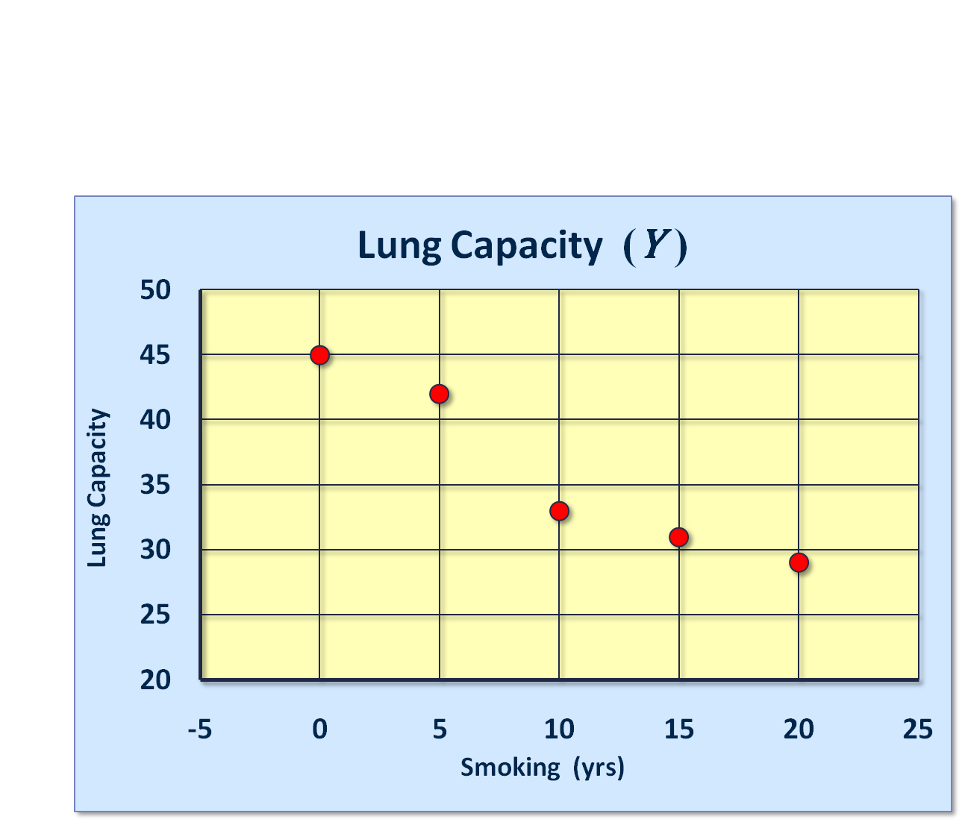
Smoking and Lung Capacity
Observe that as smoking exposure goes up, corresponding lung capacity goes down
Variables covary inversely

Slide 5
Covariance
Variables that covary inversely, like smoking and lung capacity, tend to appear on opposite sides of the group means.
When smoking is above its group mean, lung capacity tends to be below its group mean.
Average product of deviation measures extent to which variables covary, the degree of linkage between them

Slide 6
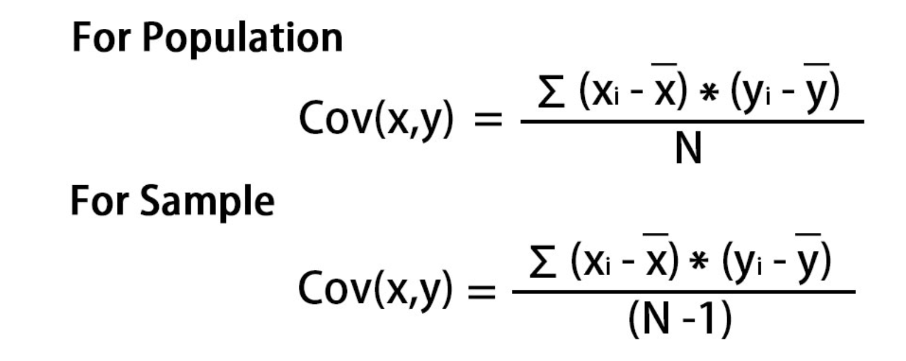
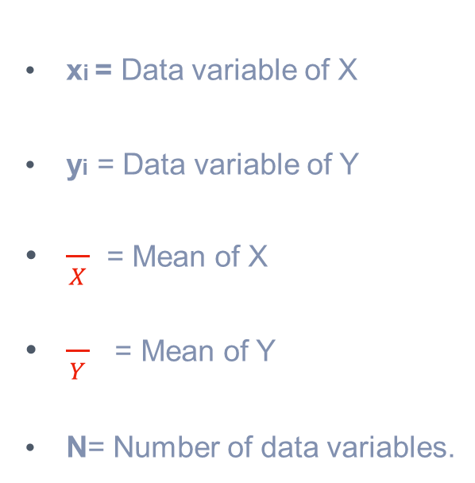
Covariance
Similar to variance, for theoretical reasons, average is typically computed using (N -1), not N . Thus,
xi = Data variable of X
yi = Data variable of Y
$\frac{}{X}$ = Mean of X
$\frac{}{Y}$ = Mean of Y
N= Number of data variables.

Slide 7
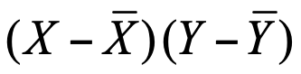
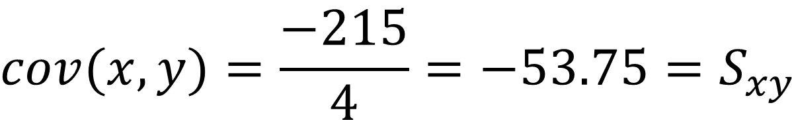
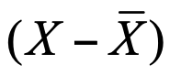
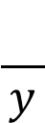
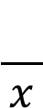
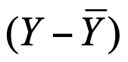
Calculating Covariance
Cigs (X ) | Lung Cap (Y )
0 | 45
5 | 42
10 | 33
15 | 31
20 | 29
10 | 36
Cigs (X ) |  |  |  | Cap (Y )
0 | -10 | -90 | 9 | 45
5 | -5 | -30 | 6 | 42
10 | 0 | 0 | -3 | 33
15 | 5 | -25 | -5 | 31
20 | 10 | -70 | -7 | 29
 |  | ∑= -215
$$\frac{}{x}$$
$$\frac{}{y}$$
$$cov(x,y)=\frac{−215}{4}=−53.75=S_{xy}$$

Slide 8
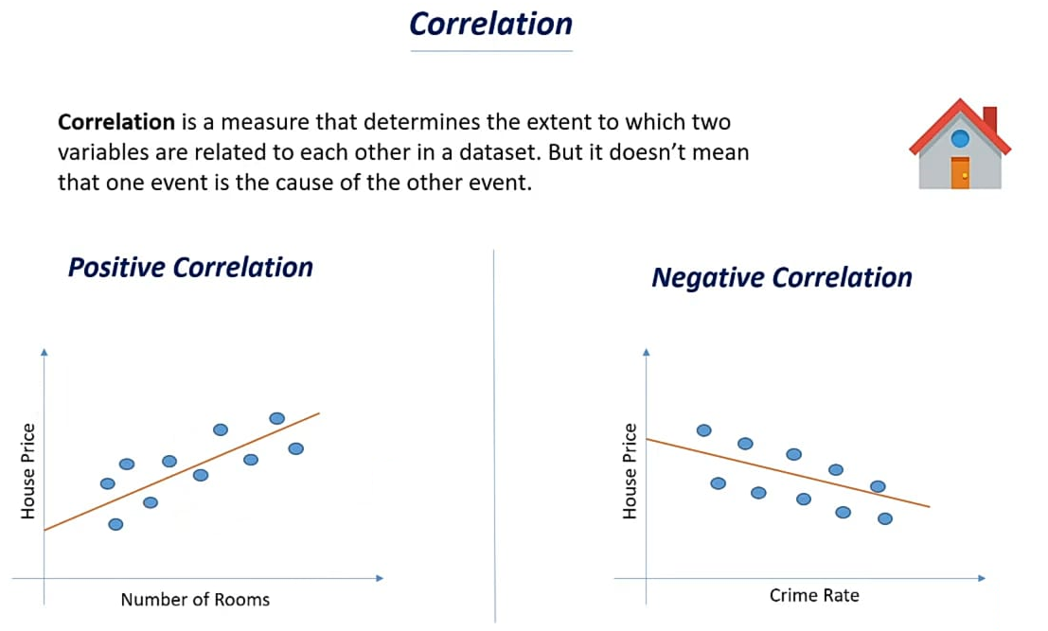

Slide 9
Correlation (rxy)
Show whether and how strongly pairs of variables are related
The main result of a correlation is called the correlation coefficient (or “r")
It ranges from -1 to 1
The closer r is to +1 or -1, the more closely the two variables are related.
If r is close to 0, it means there is no relationship between the variables.
If r is positive, it means that as one variable gets larger the other gets larger.
If r is negative, it means that as one gets larger, the other gets smaller (often called an "inverse" correlation).

Slide 10
Correlation Coefficient rxy

Slide 11
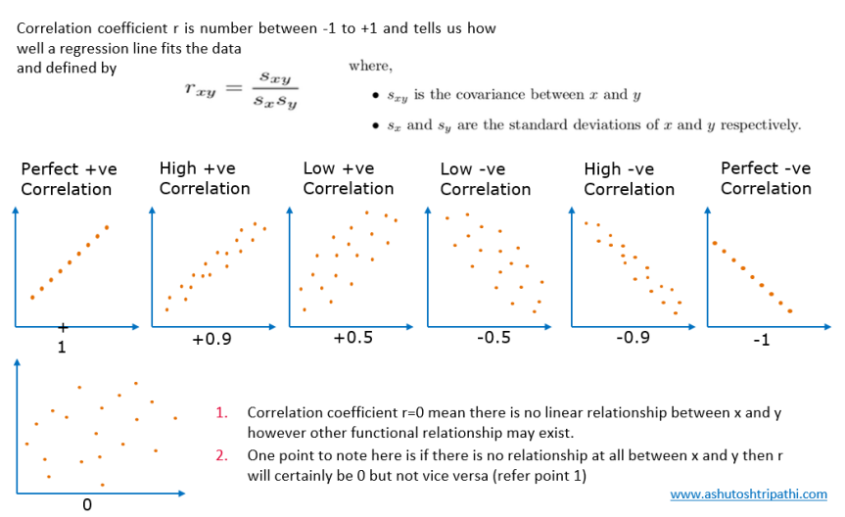

Slide 12
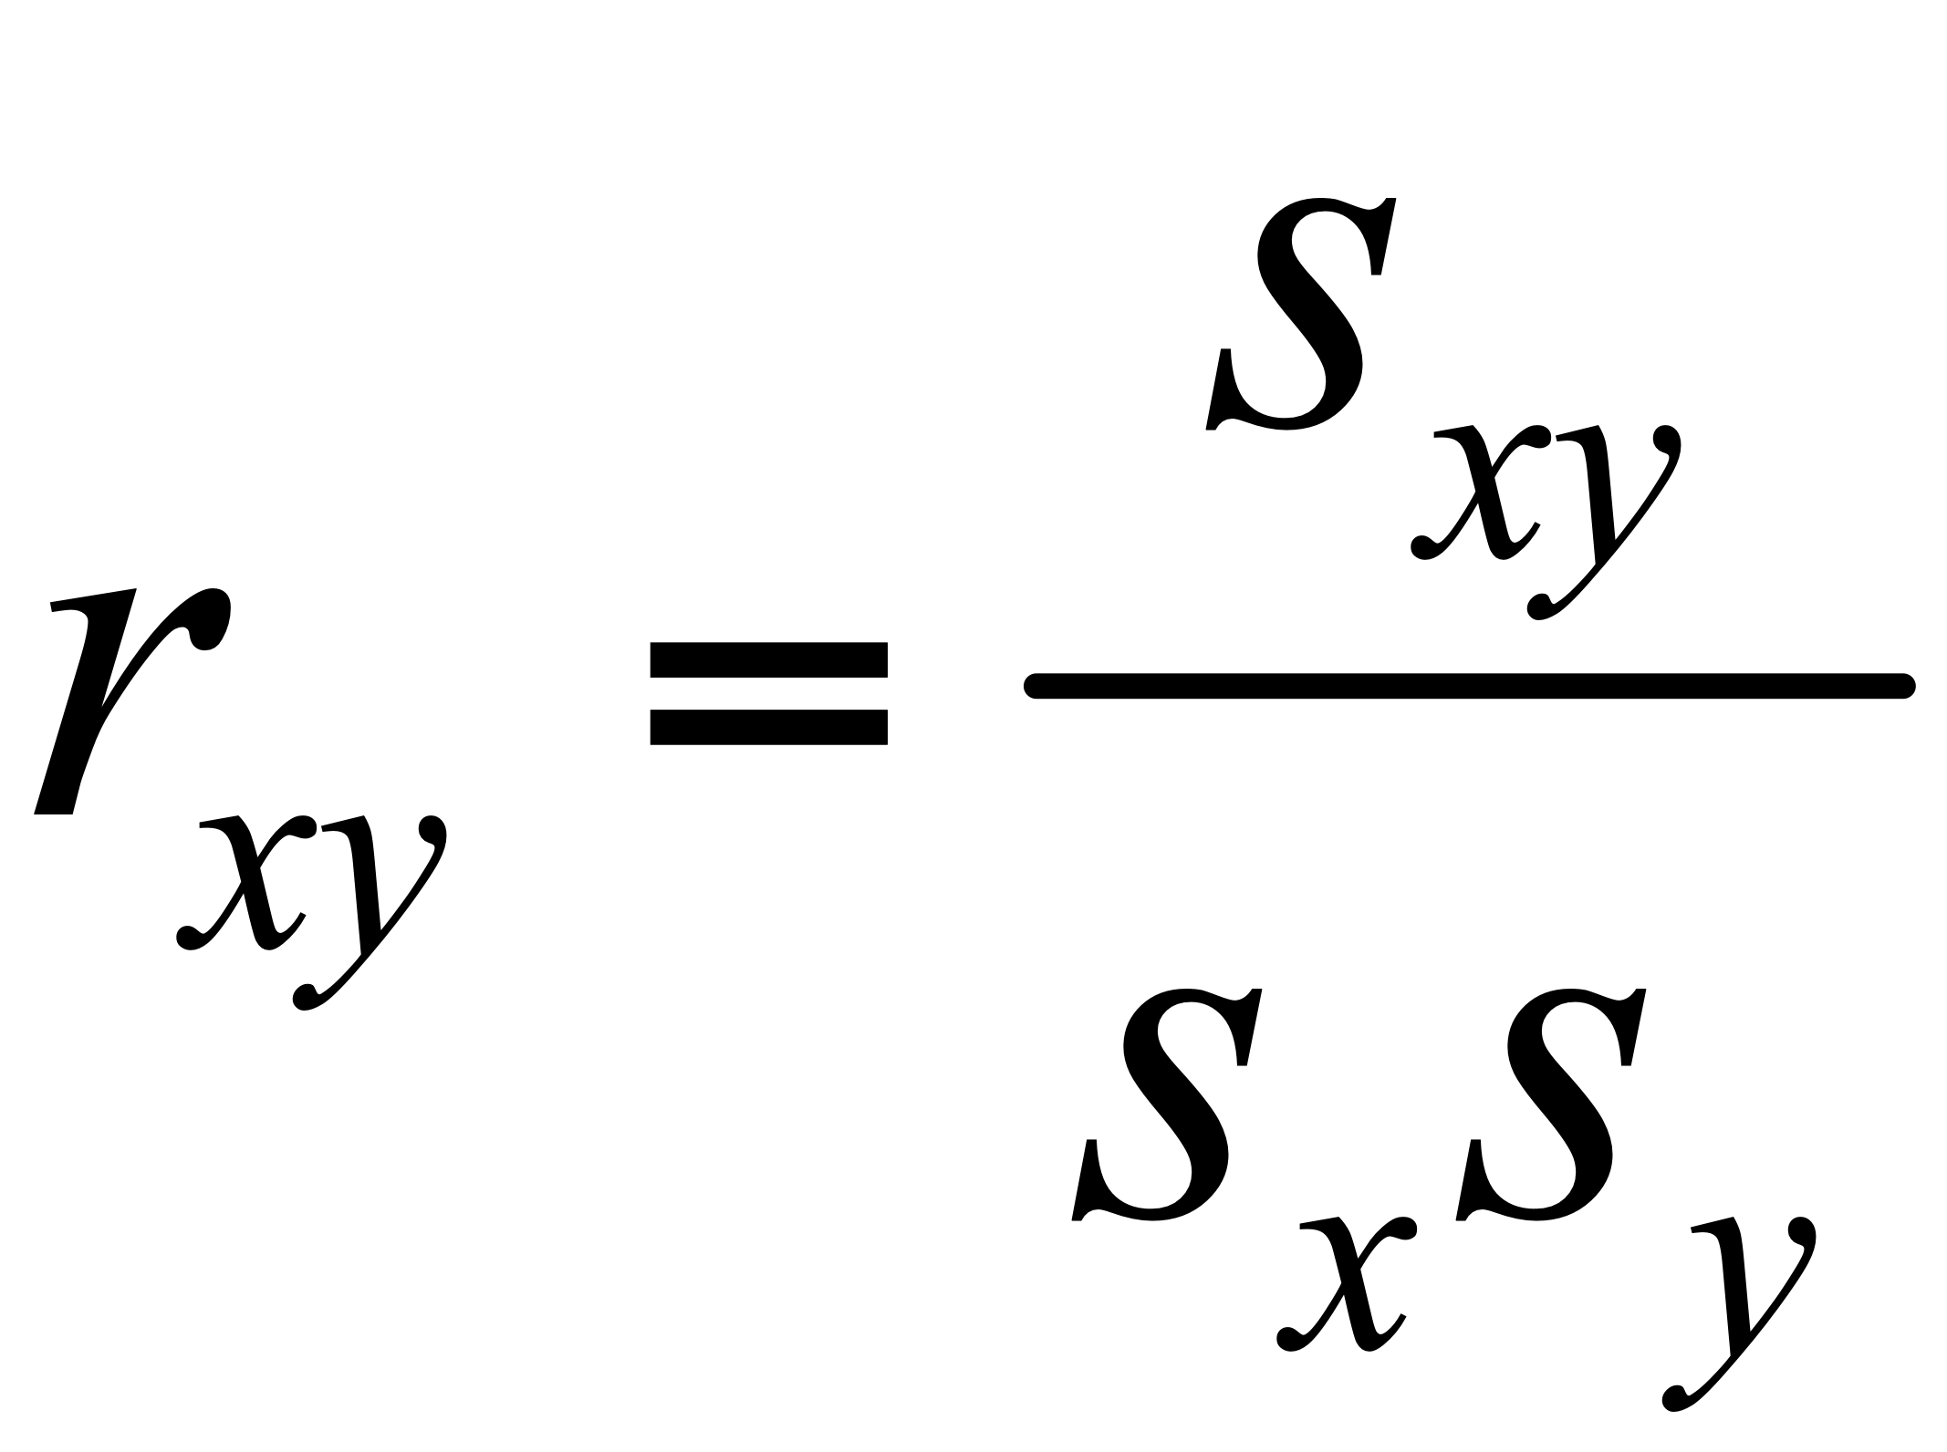
Correlation Coefficient - Common Expression
Sxy - Covariance between features x and y
Sx - Standard Deviation of X
Sy - Standard deviation of Y

Slide 13
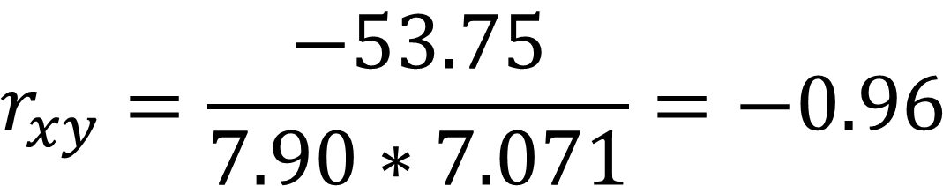
Correlation Coefficient - Common Expression
Cigs (X) | Cap (Y)
0 | 45
5 | 42
10 | 33
15 | 31
20 | 29
SD = 7.90 | SD = 7.071
$$r_{xy}=\frac{−53.75}{7.90∗7.071}=−0.96$$

Slide 14
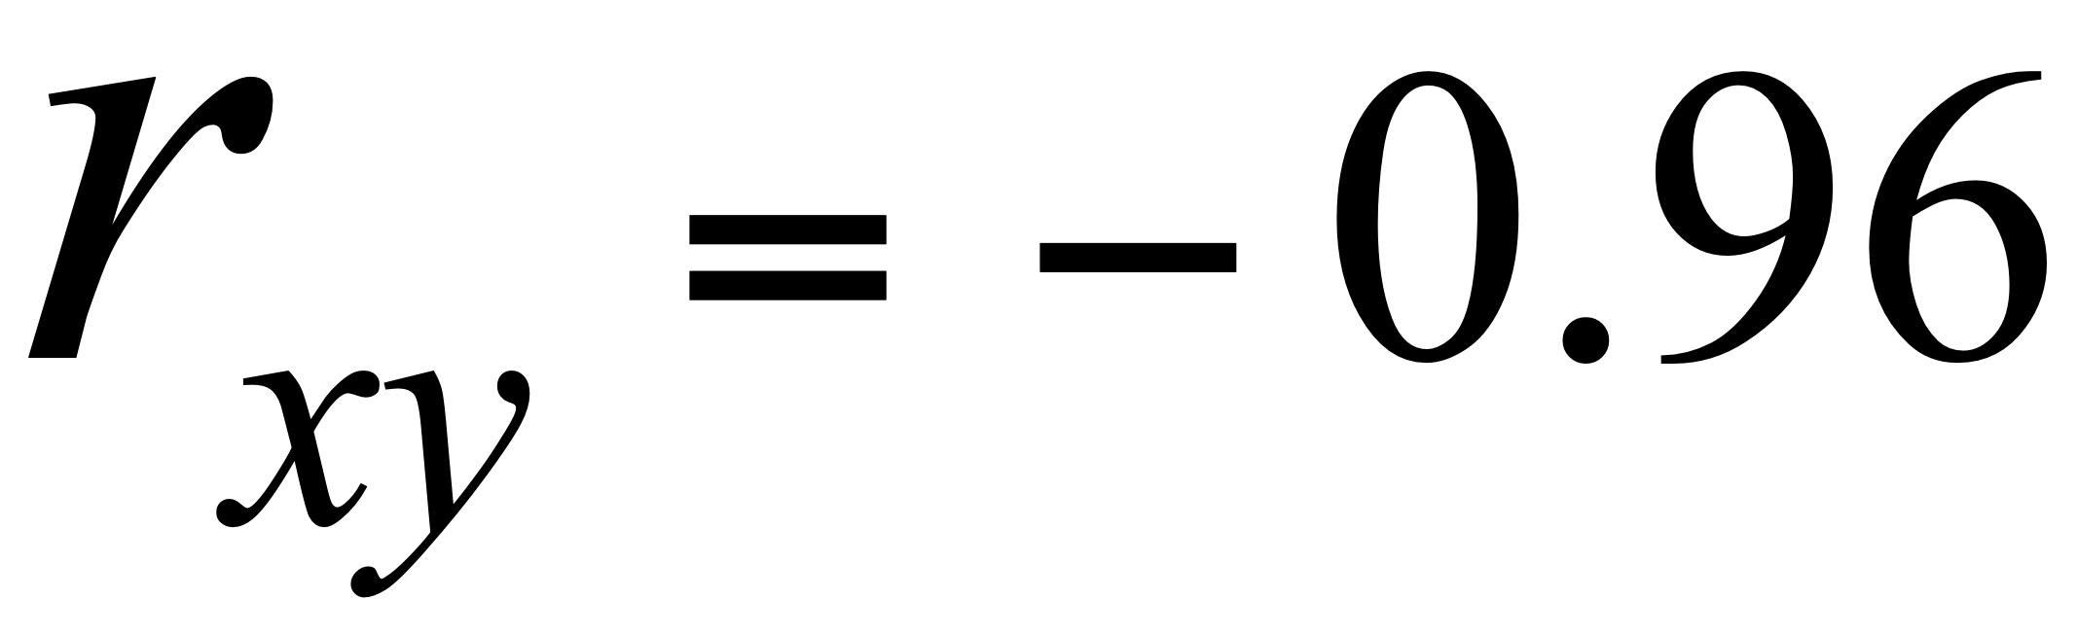
Conclusion
rxy = -0.96 implies almost certainty smoker will have diminish lung capacity
Greater smoking exposure implies greater likelihood of lung damage

Slide 15
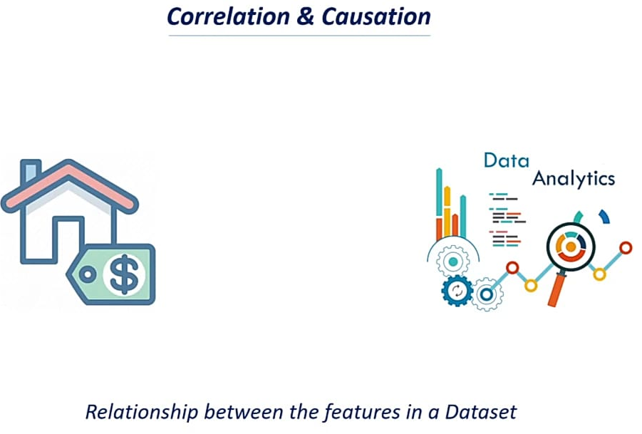

Slide 16
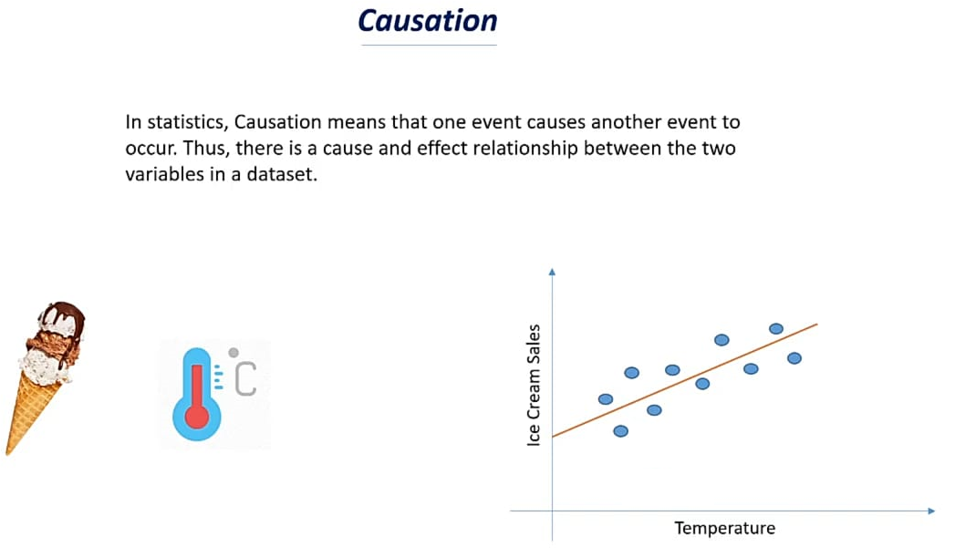

Slide 17
Rescaling of Data

Slide 18
Rescaling Data
Features are basically your column names and the respective data in that column will be of similar feature, this is in your everyday conventional datasets, most of them are usually in different quantitative measurements and in different magnitudes.
Example the column with the name height will have data in cm (centimetre) and column with weight will have data in Kg(kilogram).
Scaling data is the process of increasing or decreasing the magnitude according to a fixed ratio, in simpler words you change the size but not the shape of the data .

Slide 19
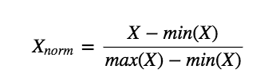
MinMax Scaler
Scaling each feature to a given range
This transformation does not change the distribution of the feature.
Feature range parameter (default at (0,1)), Consider following example
Age = [44.9, 35.1, 28.2, 19.4, 28.9, 33.5, 22.0, 21.7, 30.9, 27.9]
Height = [70.4, 61.7, 75.3, 66.8, 66.9, 61.3, 61.7, 74.4, 76.5, 60.7]
$$X_{norm}=\frac{X−min(X)}{max(X)−min(X)}∗(NewMax−NewMin)+NewMin$$

Slide 20
MinMax Scaler
Age = [44.9, 35.1, 28.2, 19.4, 28.9, 33.5, 22.0, 21.7, 30.9, 27.9]
Height = [70.4, 61.7, 75.3, 66.8, 66.9, 61.3, 61.7, 74.4, 76.5, 60.7]
After re-scaling
Age = [1, 0.61568627, 0.34509804, 0, 0.37254902, 0.55294118,
0.10196078, 0.09019608, 0.45098039, 0.33333333]
Height = [0.61392405, 0.06329114, 0.92405063, 0.38607595,
0.39240506, 0.03797468, 0.06329114, 0.86708861, 1, 0]

Slide 21
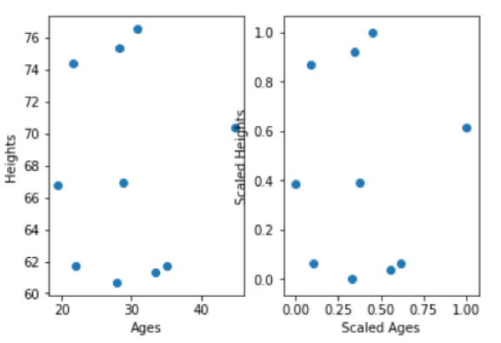
MinMax Scaler
The same distribution of data, but rescaled in such a way that distances between points won’t be biased by differences in scale
Neural networks often require their inputs to be bounded between 0 and 1.
In images, for example, where pixels can only take on a specific range of RGB values, data may have to be normalised.

Slide 22
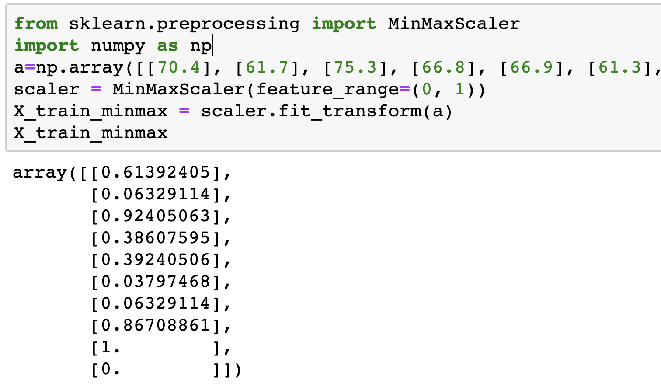
MinMax Scaler

Slide 23
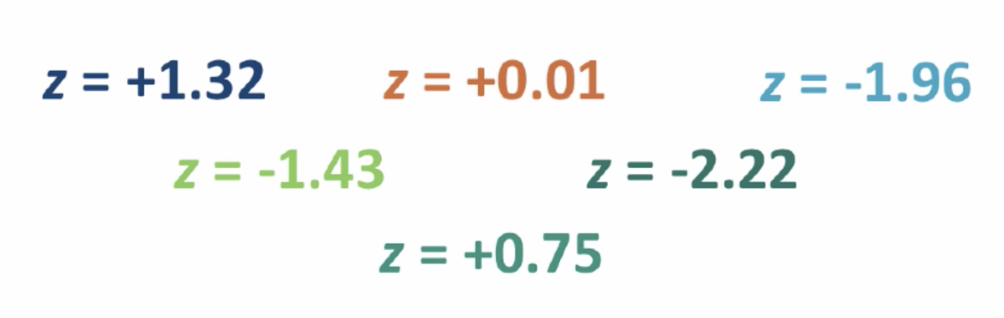
STANDARDIZE Z-Score
A Z-Score describes how far a raw score falls from the mean in the standard deviation units
Subtract the mean from the raw score
Divide by the standard deviation

Slide 24
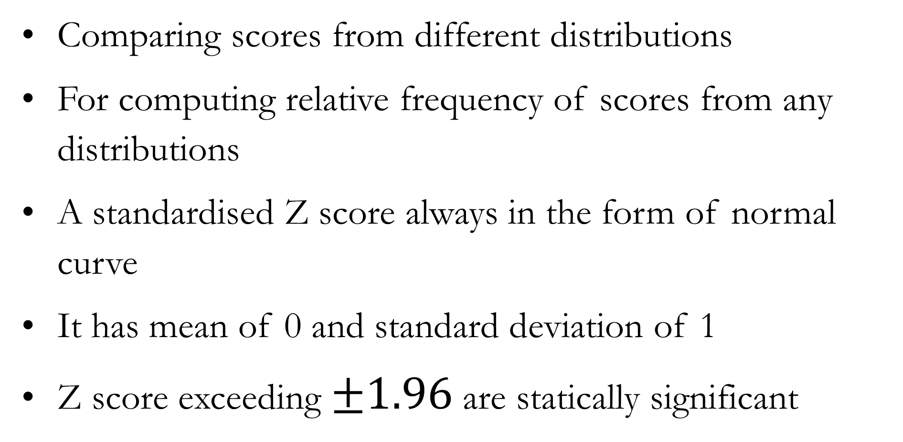
STANDARDIZE Z-Score
Comparing scores from different distributions
For computing relative frequency of scores from any distributions
A standardised Z score always in the form of normal curve
It has mean of 0 and standard deviation of 1
Z score exceeding $±1.96$ are statically significant

Slide 25
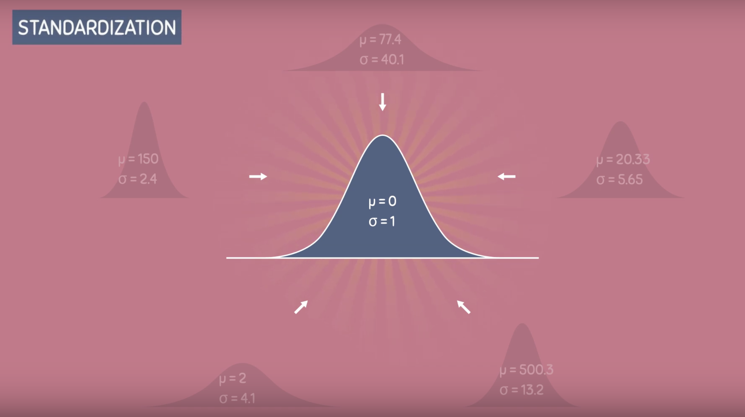
STANDARDIZE Z-Score

Slide 26
STANDARDIZE Z-Score

Slide 27
Z-Score - An example
For instance, suppose you went to college in New York and your best friend went to college in Georgia.
You might get a grade of 87 in a test with a mean of 77 and a standard deviation of 5, and the same day your friend might get a grade of 612 (mean 600, standard deviation 100).
Although the two grades (87 and 612) can’t be compared directly, the standardized values will allow you to immediately see who is doing better compared with the rest of the class.
(612 – 600) / 100 = 0.12, so your friend’s z-score or standardized grade is 0.12. (87 – 77) / 5 = 2, your standardized grade.
With standardized data you have grounds to boast to your friend that you are doing much better than he or she is in the class

Slide 28
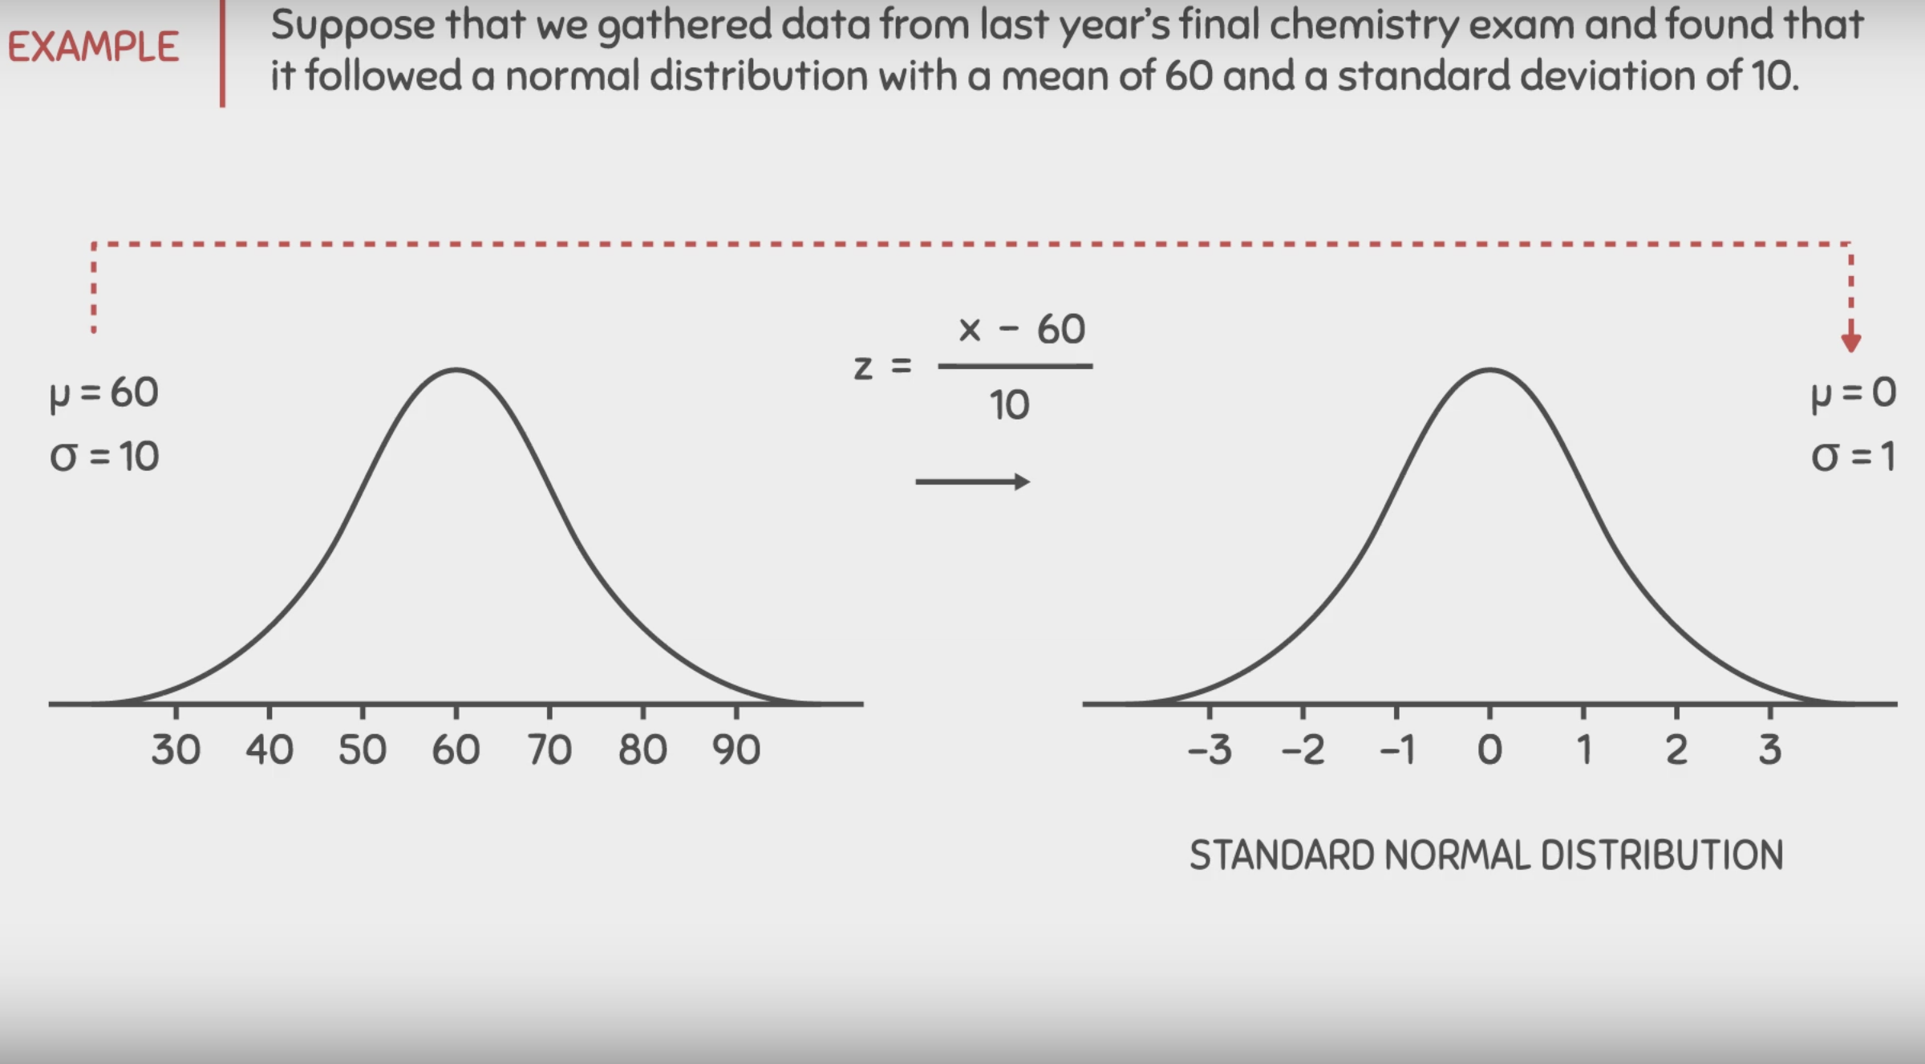
STANDARDIZE Z-Score

Slide 29
Normalize or Standardize
Normalization is good to use when you know that the distribution of your data does not follow a Gaussian distribution. This can be useful in algorithms that do not assume any distribution of the data like K-Nearest Neighbors and Neural Networks.
Standardization, on the other hand, can be helpful in cases where the data follows a Gaussian distribution. However, this does not have to be necessarily true. Also, unlike normalization, standardization does not have a bounding range. So, even if you have outliers in your data, they will not be affected by standardization.

Slide 30
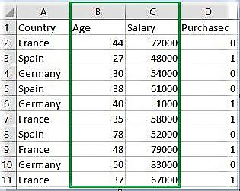
Binarize Data
All values above the threshold are marked 1 and all equal to or below are marked as 0.
This is called binarizing your data or threshold your data. It can be useful when you have probabilities that you want to make crisp values.
The process of thresholding numerical features to get Boolean values
It plays a key role in the discretization of continuous feature values.
# For age, let threshold be 35
# For salary, let threshold be 61000
binarizer_1 = Binarizer(35)
binarizer_2 = Binarizer(61000)
Example :
A continuous data of pixels values of an 8-bit grayscale image have values ranging between 0 (black) and 255 (white) and one needs it to be black and white. So, using Binarizer() one can set a threshold converting pixel values from 0 – 127 to 0 and 128 – 255 as 1.

Slide 31
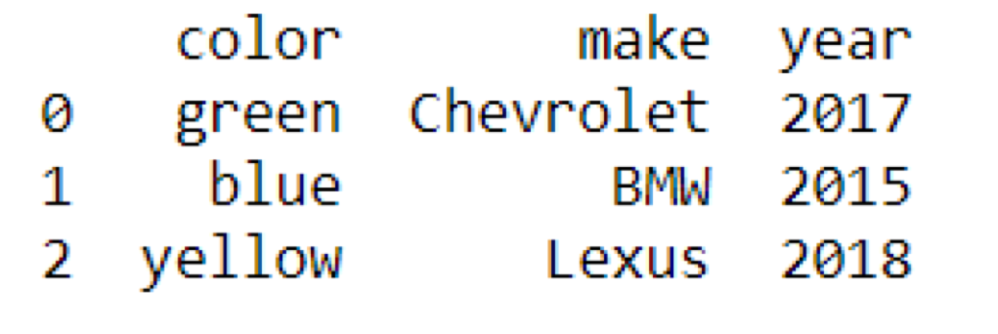
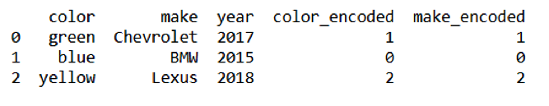
One Hot Encoding
To process categorical features, which can be in numerical or text form, they must be first transformed into a numerical representation.
Label Encoding
The first column is the color column, which is all text
Convert this kind of categorical text data into model-understandable numerical data, we use the Label Encoder
After applying the LabelEncoder, → you’ll see that the three colours in the first column have been replaced by the numbers 0, 1, and 2
The problem here is, since there are different numbers in the same column, the model will misunderstand the data to be in some kind of order, 0 < 1 < 2. But this isn’t the case at all. To overcome this problem, we use One Hot Encoder.

Slide 32
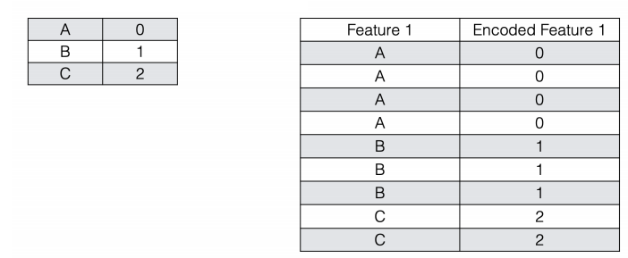
Labeled Encoding

Slide 33
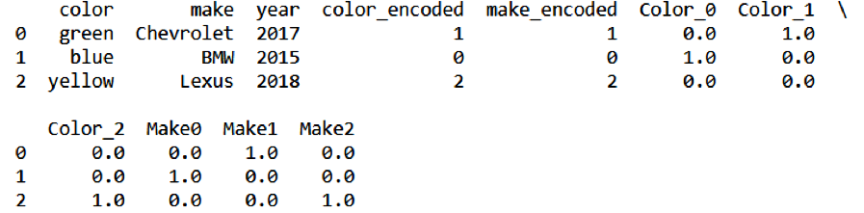
One Hot Encoding
It takes a column which has categorical data, which has been label encoded, and then splits the column into multiple columns
For k distinct values, we can transform the feature into a k-dimensional vector with one value of 1 and 0 as the rest values.

Slide 34
One Hot Encoding
Label Binarizer
The label binarizer class to perform one hot encoding in a single step
from sklearn.preprocessing import LabelBinarizer
color_lb = LabelBinarizer()
make_lb = LabelBinarizer()
X = color_lb.fit_transform(df.color.values)
Xm = make_lb.fit_transform(df.make.values)
To convert from the one-hot encoded vector back into the original text category, the label binarizer class provides the inverse transform function
print(X)
green_ohe = X[[0]]
color_lb.inverse_transform(green_ohe)

